Slide 1
External threats to business
Today’s managers work in a global environment and have to be aware of possible disruptions from outside their immediate environment. This is a brief look at a number of them.

Slide 2
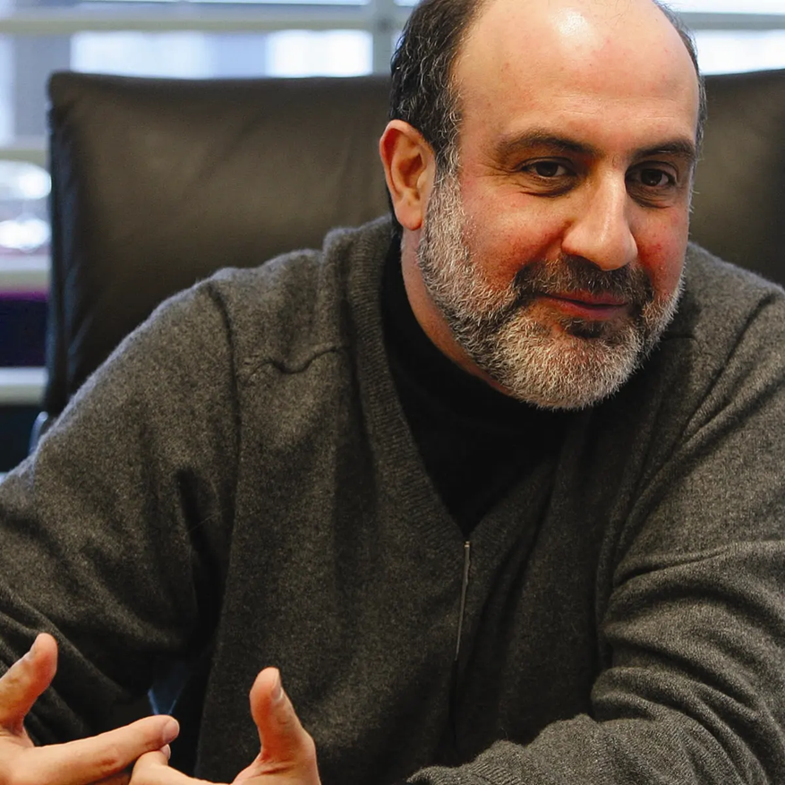
External threats
Managers of even the smallest companies are subject to pressures and threats from a variety of external sources, many of them beyond their control.
In this powerpoint we will look at four scenarios that managers have to be aware of. These include disease, unforeseen disruptions, war and failure in the capitalist system itself.
The most disruptive scenarios are known as Black Swan events, which are defined as “an unpredictable event that is beyond what is normally expected of a situation and has potentially severe consequences. Black Swan events are characterized by their extreme rarity, severe impact and the widespread insistence they were obvious in hindsight.” https://www.investopedia.com/terms/b/blackswan.asp
Black Swan events were defined by Nassim Nicholas Taleb, Professor of Risk Engineering at New York University (right).

Slide 3
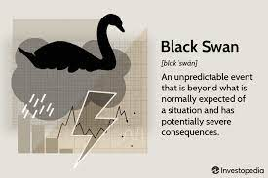

Slide 4
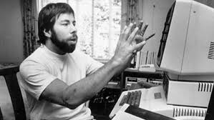
Black Swan events
Taleb was using a very old phrase to describe something highly unlikely. Until Western Australia was settled Europeans had never seen a black swan.
Taleb argues that Black Swan events are hard to predict based on information available before the event. As examples he cites personal computers, The Beatles, Harry Potter and the First World War. As you can see, not all Black Swan events are necessarily all bad.
He describes these events as having low predictability, but high levels of consequence. He said that when the events are over people start claiming that of course they saw it coming.
Steve Wozniak, the man who really invented the Apple computer.

Slide 5
Black Swan events
Rather than thinking of them primarily as good or bad, it is more convenient to think of Black Sawn events as disruptions. The invention of the home computer was certainly unforeseen except by a tiny band of computer nerds with a vision.
The explosion in digital technology changed the way we do virtually everything. If you owned a camera shop, for instance, and didn’t see the tidal wave of digital cameras coming and kept selling only film cameras, you were probably doomed.

Slide 6
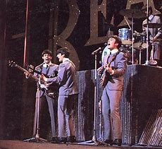
Black Swan events
Similarly, if you owned a book shop and didn’t understand what a cultural phenomenon Harry Potter was, you were in trouble.
Ditto the idiot at Decca records who rejected the Beatles on the grounds that “guitar groups were on the way out.”
He must have had a lot of explaining to do when they became the biggest selling group on the planet.

Slide 7
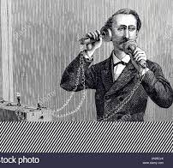
Black Swan events
Sometimes people just misjudge the impact technology will have.
Both the mayor of Chicago and Alexander Graeme Bell are claimed to have said of the telephone: ”One day every city in America will have one.”
The British writer Arthur C.Clarke was fond of quoting a remark made by the British Postmaster General, who supposedly said: “We do not need the telephone. We have enough messenger boys.”

Slide 8
Covid-19
Canadian academic Glenn McGillivray argues that Covid-19 is not a Black Swan event, saying that outbreaks of disease happen regularly and can be prepared for. For McGillivray, applying Taleb’s terminology is highly dangerous: “The danger of making an occurrence like the Covid-19 outbreak appear to be astronomically rare is that we will treat it as such and fail to prepare for the next pandemic. What’s more, those accountable for this preparation will dismiss their blatant failures because of the perceived exceptional nature of the event.”
https://theconversation.com/coronavirus-is-significant-but-is-it-a-true-black-swan-event-136675

Slide 9
Covid-19
Whether Covid-19 is a Black Swan event or not, McGillivray warned when it started that “There can be no question that the current pandemic has had — and will continue to have — an extreme impact, both on people and on national economies.” https://theconversation.com/coronavirus-is-significant-but-is-it-a-true-black-swan-event-136675
Taleb was highly critical of the way governments have handled the pandemic, saying that reacting to it properly as early as possible was the most sensible economic action (https://www.youtube.com/watch?v=ePmSa-n7kBA&t=412s).
In countries like New Zealand, which reacted early to the pandemic and took decisive action to support people and business and eliminate the virus as far as practically possible, the economic blow has been softened.

Slide 10
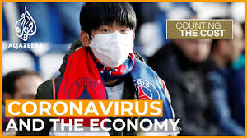
Covid-19
Fortune described New Zealand as being one of a handful of countries – it identified the others as China, Taiwan and Ireland – to have made a full recovery. https://fortune.com/2020/12/17/new-zealand-covid-lockdown-economy-recovery/
Unfortunately, the fact is that people still lost their jobs, businesses shut down and factors such as border closures eliminated large sections of industry, grounded airlines and disrupted supply chains. It may be years before the global economy fully recovers.
The World Bank predicts a slow recovery: https://www.worldbank.org/en/news/press-release/2022/01/11/global-recovery-economics-debt-commodity-inequality
Al Jazeera had this to say: https://www.aljazeera.com/program/counting-the-cost/2022/1/8/what-lies-ahead-for-the-global-economy-in-2022

Slide 11
How much is Covid 19 to blame?
But how much is Covid-19 really to blame? How much Covid-19 will be blamed for a business failing in years to come is uncertain, but commercial research in the UK, where several huge high street brands disappeared in the first year of the epidemic, argues that the pandemic was merely the last straw for some businesses.
For instance, the fate of Debenhams, the most high profile high street trader to vanish, was the victim of years of poor management and neglect rather than the virus. Like other traders, it had already begun closing shops before the pandemic. https://www.retailresearch.org/whos-gone-bust-retail.html

Slide 12
War
Wars rarely come as a complete surprise. The First World War (1914-18) has been described as a Black Swan event because most people did not think European leaders would be so stupid. The Second World War (1939-45), on the other hand, was expected.
The First World War destroyed the German, Austro-Hungarian, Russian and Ottoman Empires. The Second World War destroyed the Japanese and Italian empires and, over the next 30 years, led to the end of the British and French empires.
The First World War was an economic catastrophe that ultimately led to the Great Depression. The Second World War bankrupted Britain and made the United States the most powerful economy in the world.

Slide 13
Combined effects
Senior UN economists that economic growth in 2023 will slow to 1.9%.
Intersecting crises are likely to add further damage to the global economy..
This will be one of the lowest growth rates in recent decades, apart from during the 2007-8 financial crisis and the height of the COVID-19 pandemic.
Tweet URL
“In most countries we expect that private consumption and investment will weaken due to inflation and higher interest rates”, said Ingo Pitterle, Senior Economist at the UN Department of Economic and Social Affairs.
“Several countries will see a mild recession before growth is forecast to pick up in the second half of this year and into 2024”.
The findings come amid the backdrop of the pandemic, the war in Ukraine and resulting food and energy crises, surging inflation, debt tightening, as well as the climate emergency.
In the near term, the economic outlook is gloomy and uncertain with global growth forecast to moderately pick up to 2.7 per cent in 2024.
However, this is highly dependent on the pace and sequence of further monetary tightening – rising interest rates - the consequences of the war in Ukraine, and the possibility of further supply-chain disruptions.
https://news.un.org/en/story/2023/01/1132822

Slide 14
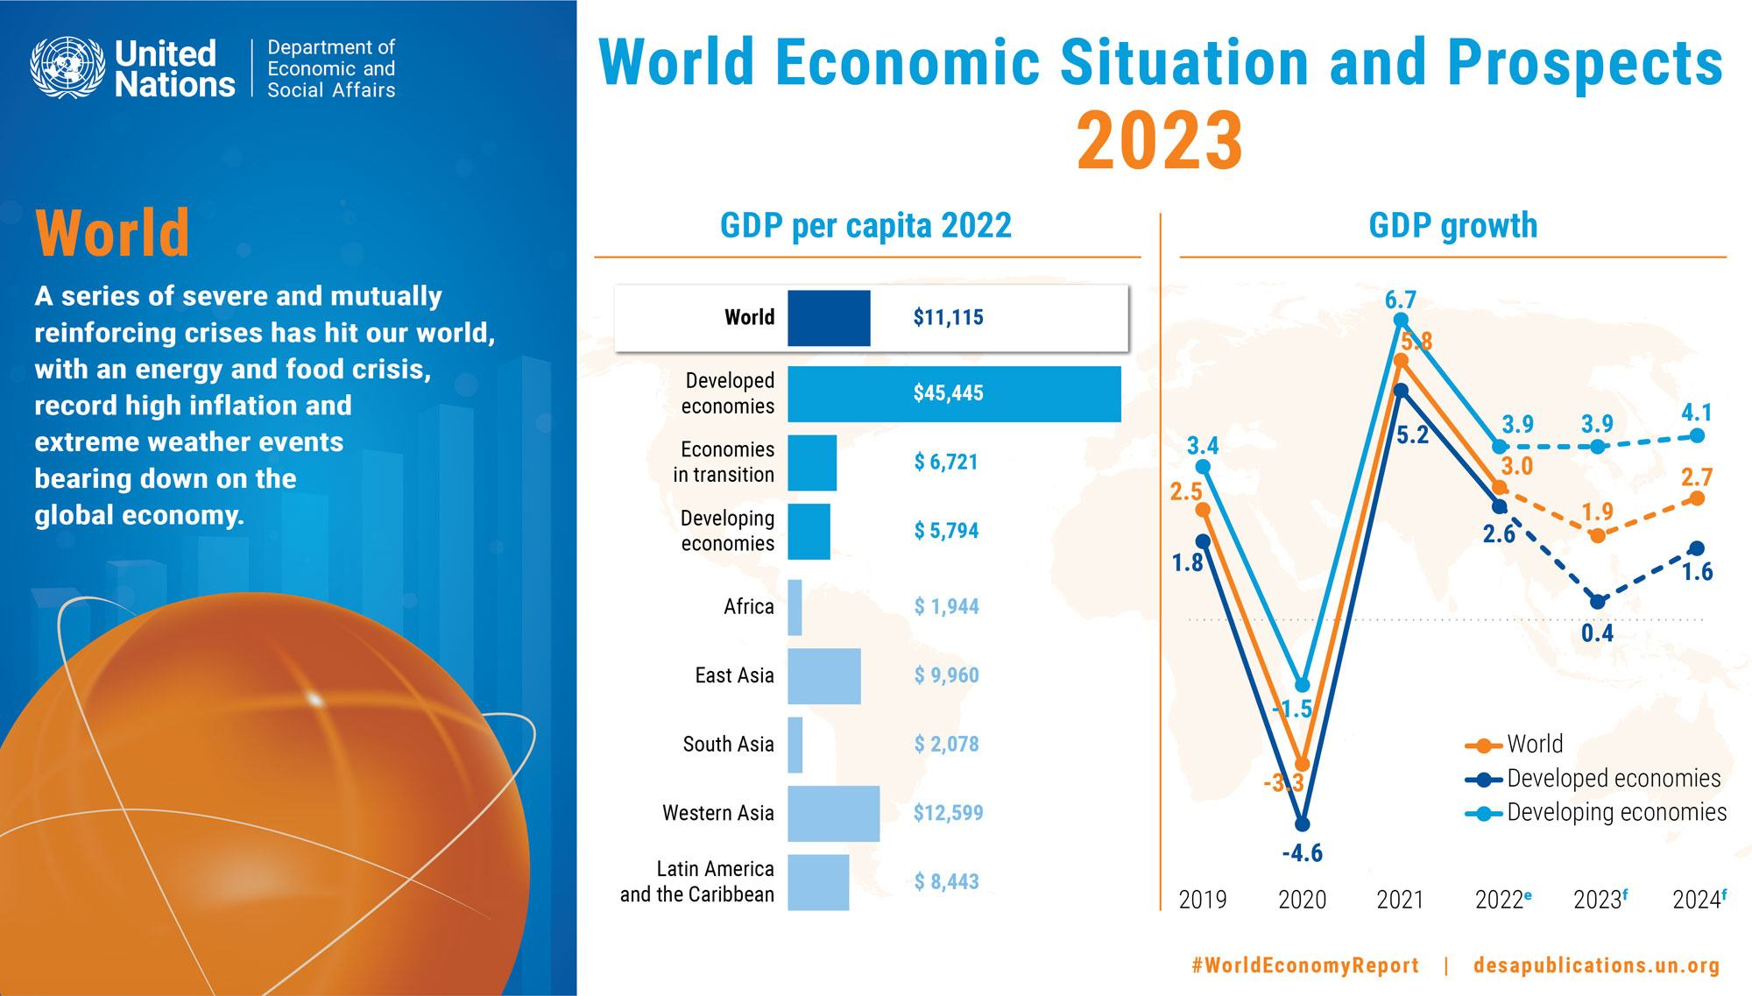

Slide 15
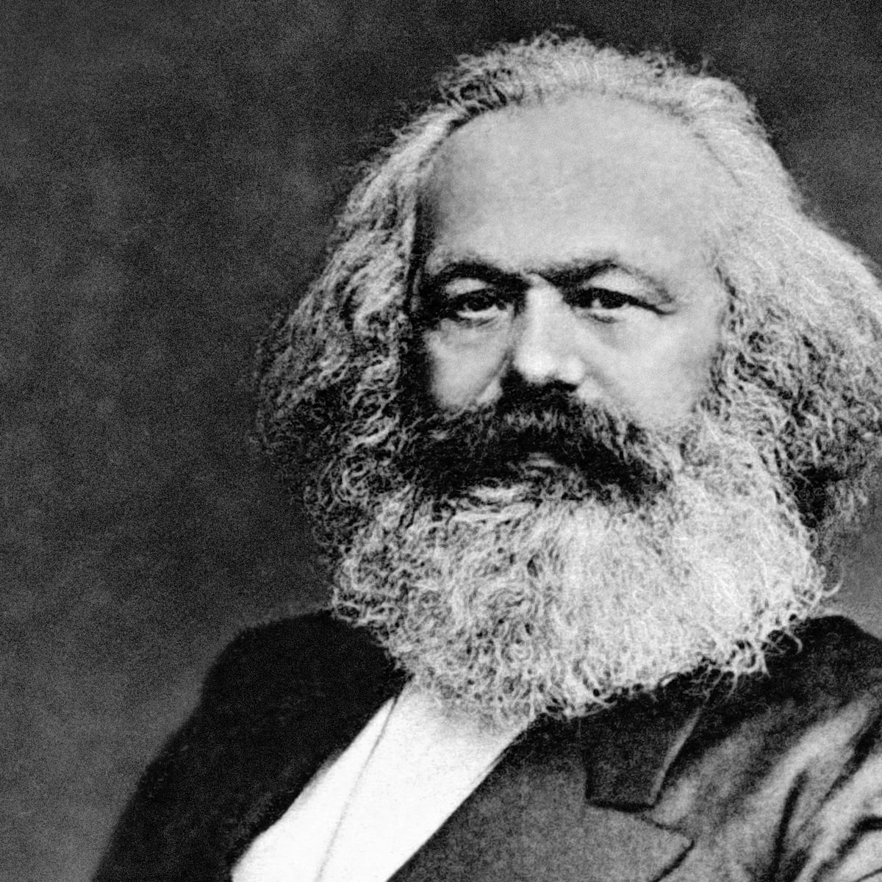
Is there a Black Swan event lurking inside capitalism?
Karl Marx, who, with Friedrich Engels, was the father of Communism, argued that capitalism contained within itself the seeds of its own destruction.
There are western economists who argue that there are indeed severe faults in the capitalist system in which all businesses operate.

Slide 16
Are there faults in the system?
Many current philosophers and economists see very great moral and ethical problems with the current form of capitalism, which is extremely close to the unfettered - laissez faire - capitalism that Marx and Engels condemned in the 19th century.
Others argue that globalisation itself is a threat because it makes nations dependent on one or two countries for everything and destroys their ability to be self-reliant in time of crisis.

Slide 17
Are there faults in the system?
Others see the behaviour of an uncontrolled system as an invitation to greed and corruption that endangers the livelihoods of those who constitute its market.
<<Perhaps the most viral cancer to afflict the [economic] system [have] been the egregious manifestations of unethical, immoral and in many cases illegal behavior of major corporations, especially . . . in the field of finance. In the eyes of many the whole system seems to be corrupt and unjust. Banks destroy billions of dollars of wealth, while over a billion people do not have access to proper sanitation, potable water and sufficient calories. Hundreds of millions of children go to bed hungry, while the men . . . . whose incompetence and possible immorality have done so much harm to global finance earn outrageously high salaries and bonuses.>>
from Jean-Pierre Lehman. “What’s it for?” – Moral responsibility in an age of globalization https://www.cepweb.org/whats-it-for-moral-responsibility-in-an-age-of-globalisation/

Slide 18
Are there faults in the system?
<<Simon Tormey, a political theorist at The University of Sydney, says the problems of capitalism depend on the governing system it operates within.
“What has tended historically to dictate which end of the [ethical] spectrum capitalism appears on is the ability of ordinary people to rein back capitalism’s excesses through the actions of the state on the one hand, and of social movements such as trade unions on the other”, he says.
“Countries with strong states and strong social movements are able to develop forms of capitalism that are quite ethical in this respect and Scandinavia would perhaps offer the most complete examples.”
Trevor Treharne, Capitalism is global, but is it ethical? https://ethics.org.au/capitalism-is-global-but-is-it-ethical/

Slide 19
Are there faults in the system?
“However, countries where there is authoritarian governance, where trade unions and other social movements are weak, are often characterised by a highly unethical and obnoxious form of capitalism that prays on individual weakness to generate profits for a small minority.”
In other words, depending where a business is operating may have a tremendous effect on its survival. If people perceive the capitalist system as a threat they will lose faith in it. If they perceive it as operating for the benefits of a few oligarchs then – and indeed if it is being run for the sake of a tiny handful of people – then eventually people will no longer trust it and the system will break down.

Slide 20
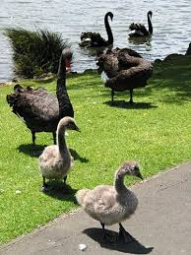
Last thoughts
And finally . . . .
Here are some real black swans at Western Springs Park in Auckland.
The parents are fine, but the cygnets will try to eat your shoelaces.
Black swans are native to Western Australia and were imported into New Zealand by Governor Grey in the 19th century.

